Slide 1
GROUP 20
DESIGN OF A 16 BIT MICROPROCESSOR
GROUP MEMBERS INDEX NUMBERS
DE-ROY EKOW SAGOE 8246219
NANA SAM YEBOAH 8248119
ADDAE DANIEL ARTHUR 8226019
DZAM KOFI WORLASI 8235219
WINSTON NENE SACKEY 8246119
FREDERICK YAW NTIAMOAH-SARPONG 8242919
JOEL BANKAM 8231619
NIMAKO CALEB GYAMFI 8242619

Slide 2
Overview of the microprocessor
Data bus width-16 bits
Address bus width-16 bits
Registers- 4 bits( 16 registers)
Instructions-4 bits( 14 instructions)

Slide 3
Instruction set architecture
The ISA is the blueprint of the of the microprocessor. It defines the design and structure of the microprocessor. This microprocessor can perform 14 instructions which have been categorized into four instruction formats. The classification is as follows:
R-type/ ALU instrucions
Memory instructions
Load and store instruction
Branch instruction
branch equal and branch not equal
jump.
I type instruction
Mov reg, imm
Mov mem, imm

Slide 4
Instructions set
Instructions | Opcode
AND | 0000
NOT | 0001
OR | 0010
NOR | 0011
ADD | 0100
SUBTRACT | 0101
MULTIPLY | 0110
DIVIDE | 0111
LOAD | 1000
STORE | 1001
BEQ | 1010
BNEQ | 1011
JUMP | 1100
IMMEDIATE | 1101

Slide 5
Arithmetic instructions
They are simply instructions performed by the ALU, such as mathematical calculations and logical operations. A total of 8 instructions we picked fall under this category.
The instructions in specific order are and, not, or, nor, add, sub ,mul, div.
Their instruction format is as follows;
Opcode | Rd | Rs2 | Rs1
4 bits | 4 bits | 4 bits | 4 bits
15:12 | 11:8 | 7:4 | 3:0

Slide 6
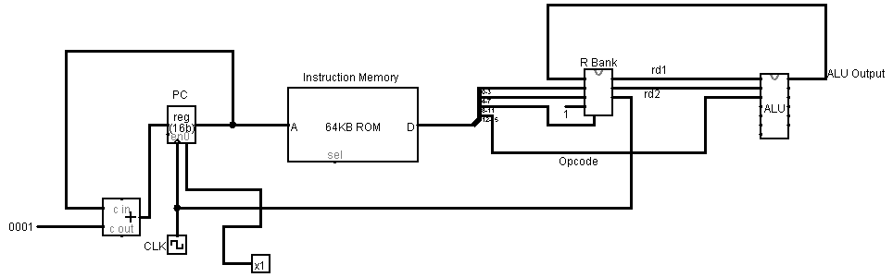
Data path for arithmetic instructions

Slide 7
Memory instructions
These are instructions that are implemented to guide the flow of data between memory and registers. They are used to read and write data from and to memory.
The two instructions we chose are load and store.
Load allows us to read data from memory
Store allows us to write data to memory

Slide 8
Load instruction
In performing a load instruction , values/data are taken from memory to any of the 16 registers.
Instruction format for load. To address the entire memory, base address indexing was used.
Opcode | Rd | Memory address
 |  | Rs2 | Offset
4 bits | 4 bits | 4 bits | 4 bits
15:12 | 11:8 | 7:4 | 3:0

Slide 9
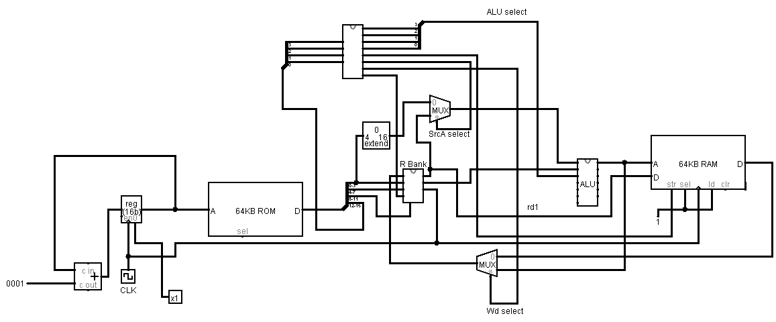
Data path for load instruction

Slide 10
Store instruction
With the execution of the store instruction, data is picked from any of the 16 registers and is put in memory.
Instruction format
Opcode | Memory address |  | Rs1
 | Offset | Rs2
4 bits | 4 bits | 4 bits | 4 bits
15:12 | 11:8 | 7:4 | 3:0

Slide 11
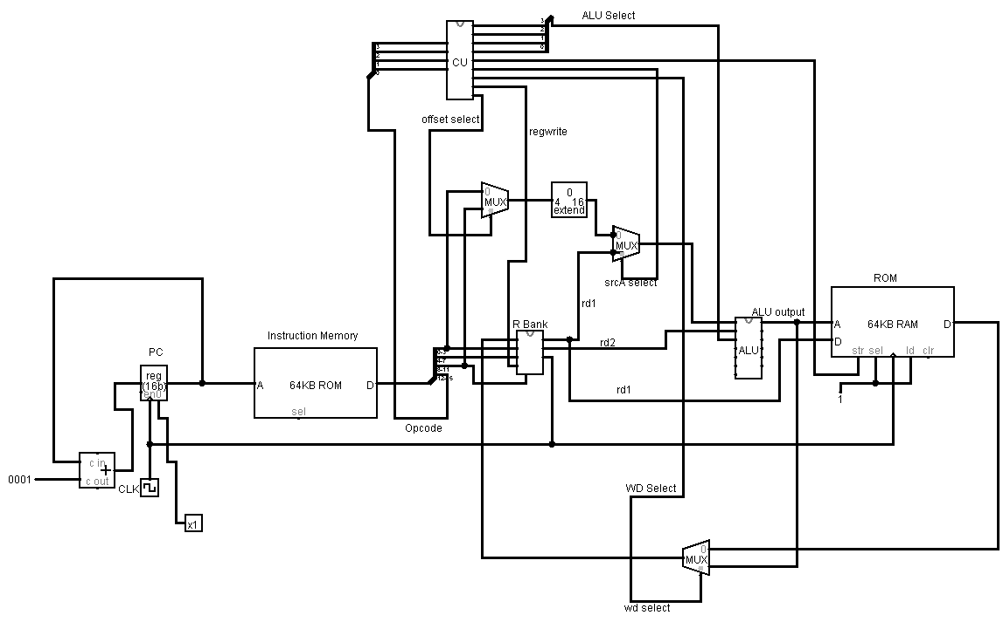
Data path for store instruction

Slide 12
I-type instructions
operation | Opcode | Rd | Rs1 | Rs2
Reg,imm | 1101 | 4 bits | x | x
Mem,imm | 1110 | x | [base address] | offset
 | 15:12 | 11:8 | 7:4 | 3:0

Slide 13
Control flow instructions
These are instructions we chose in implementing conditional and unconditional statements in working algorithms .
The three instructions under this set are; branch if equal(beq) and branch if not equal(bneq) for conditional statements and jump(j) for unconditional statements.

Slide 14
Conditional Branch instruction
These are instructions that allow the program counter to jump either forward or backwards(specified by branch offset) through a series of line of code based on a given condition. The condition is checked by comparing the two values in Rs1 and Rs2
These instructions are the branch if equal(beq) and the branch if not equal(bneq).
Instruction format
Opcode | Branch offset(B.O) | Rs2 | Rs1
4 bits | 4 bits | 4 bits | 4 bits
15:12 | 11:8 | 7:4 | 3:0

Slide 15
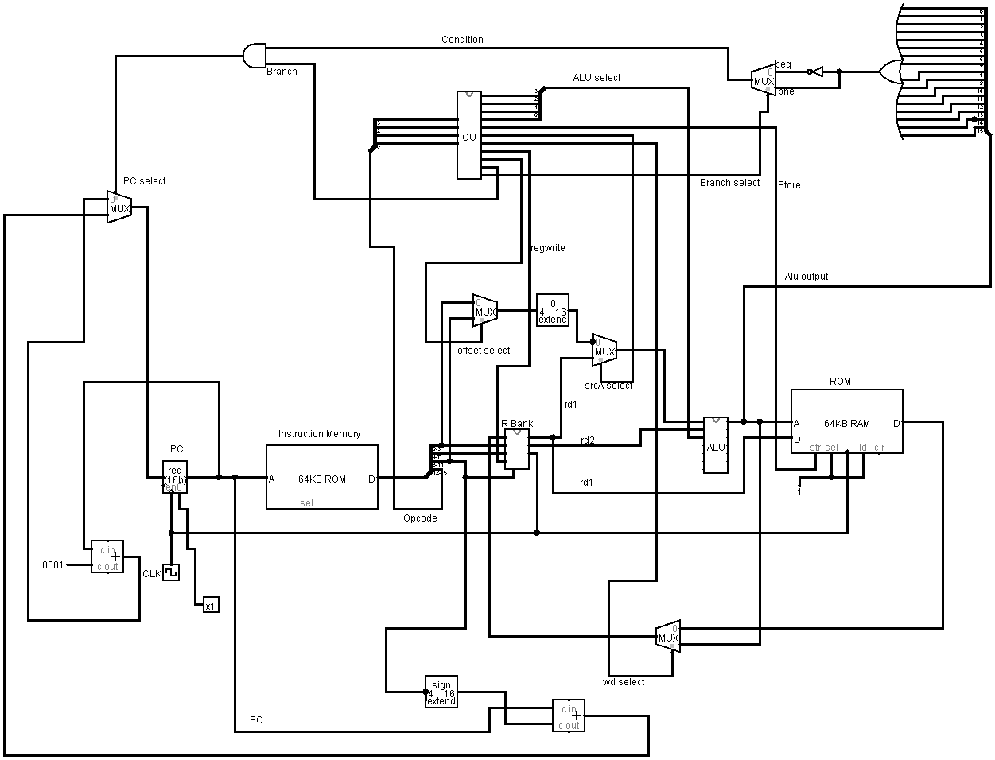
Data path for branch instruction

Slide 16
Unconditional branch instruction
This instruction allows the program counter to jump either forward or backwards through a series of line of code without any condition.
The jump instruction is implemented for this instruction.
Instruction format
Opcode | Jump offset
15:12 | 11:0

Slide 17
HARDWARE REALIZATION
Program counter
The program counter loops through the instruction memory. When the clock clock is toggled.
Memory
A 64kb data memory was interfaced with the microprocessor to store information.

Slide 18
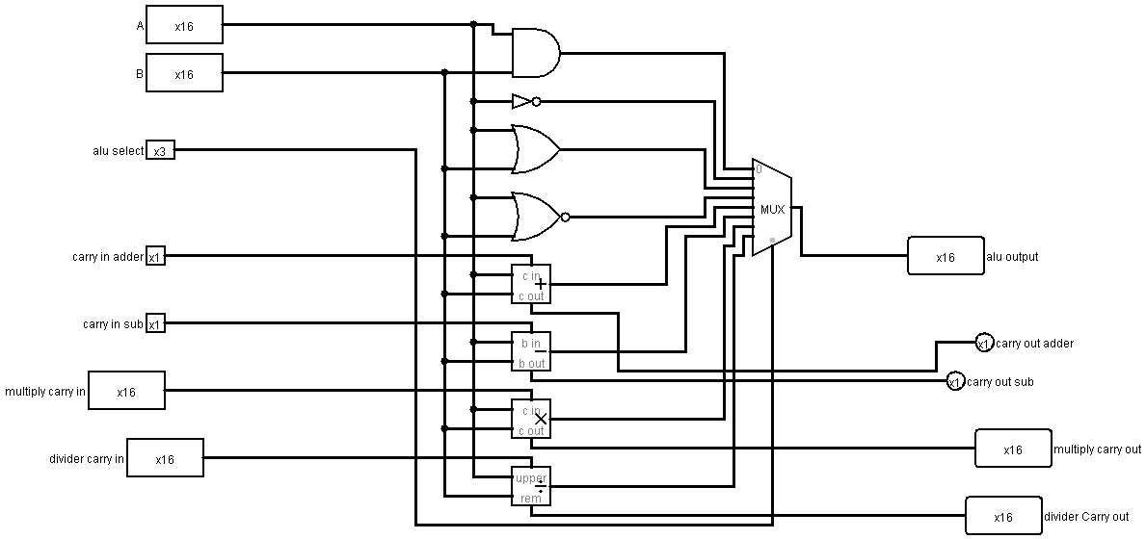
Arithmetic and logic unit
It performs the arithmetic and logic operations of the processor. Our microprocessor performs 8 ALU instructions.

Slide 19
Register bank
The register bank is a temporal storage space within the microprocessor. Our register bank contains 16 registers.

Slide 20
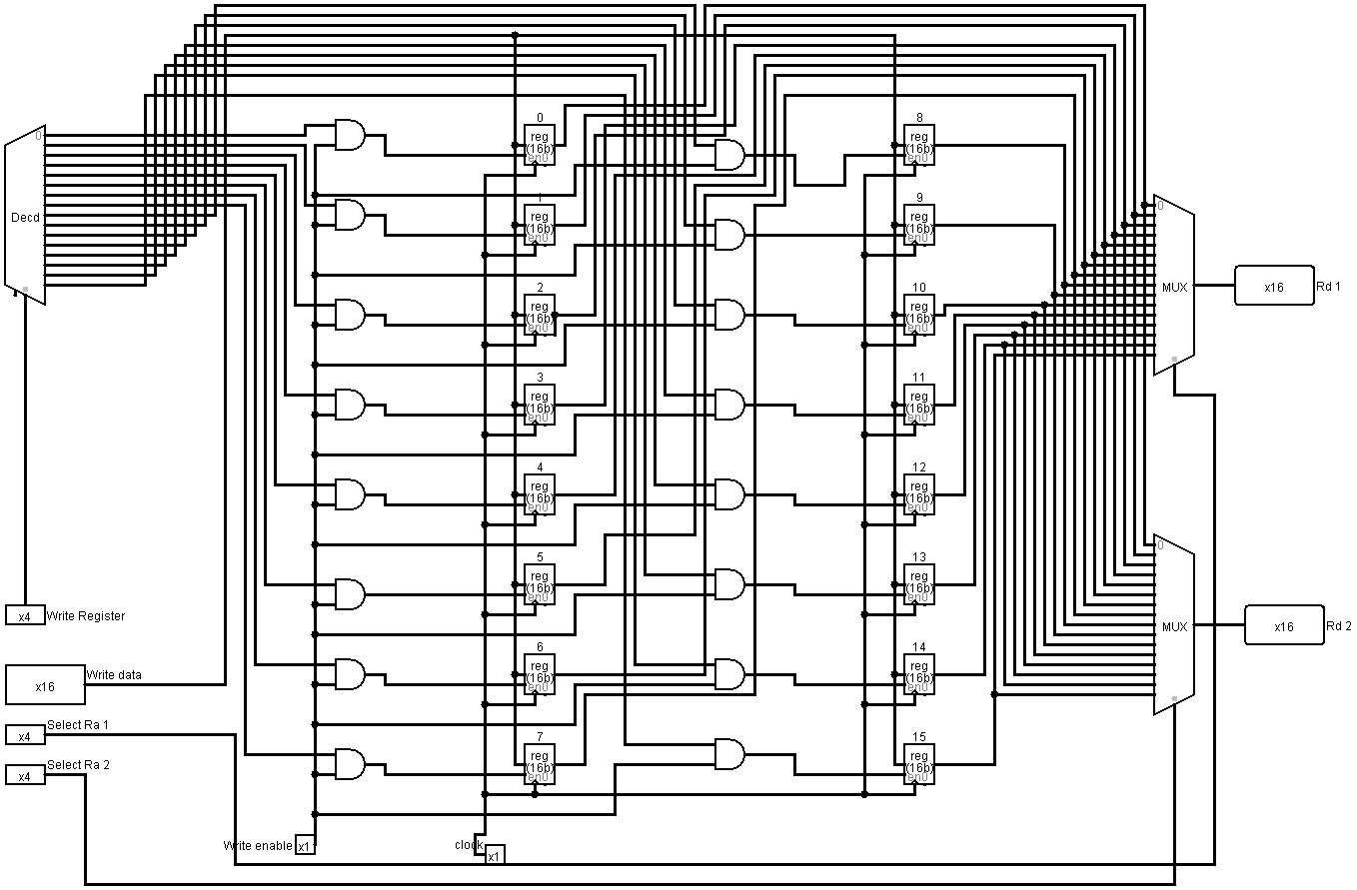
Register bank Design

Slide 21
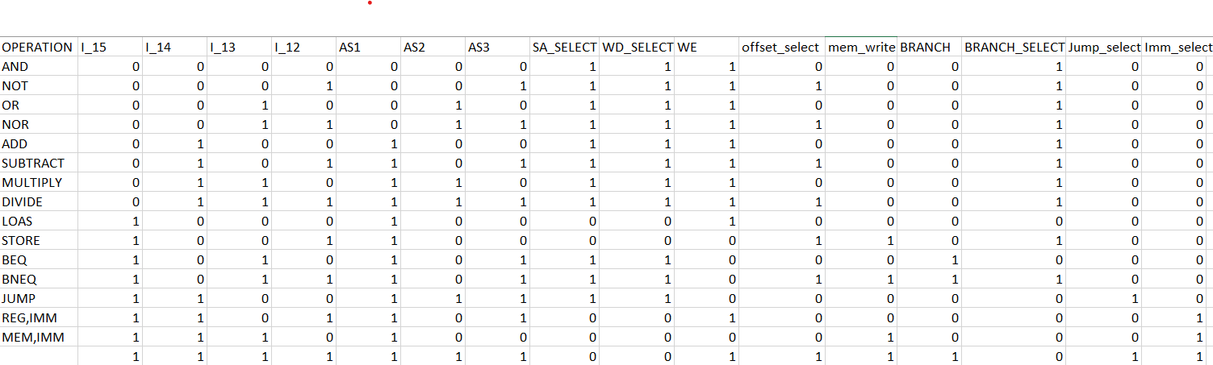
Control unit
The control unit produces control signals to oversee the operations and coordination of various hardware components embedded in the processor.

Slide 22
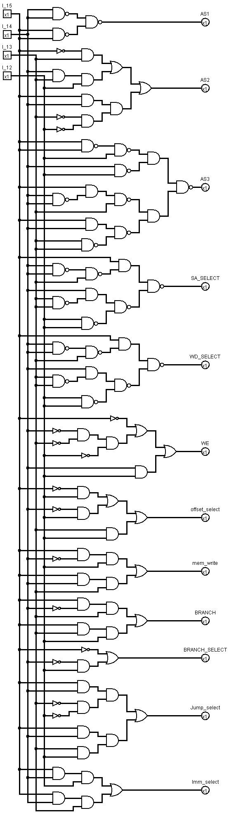
CONTROL UNIT DESIGN

Slide 23
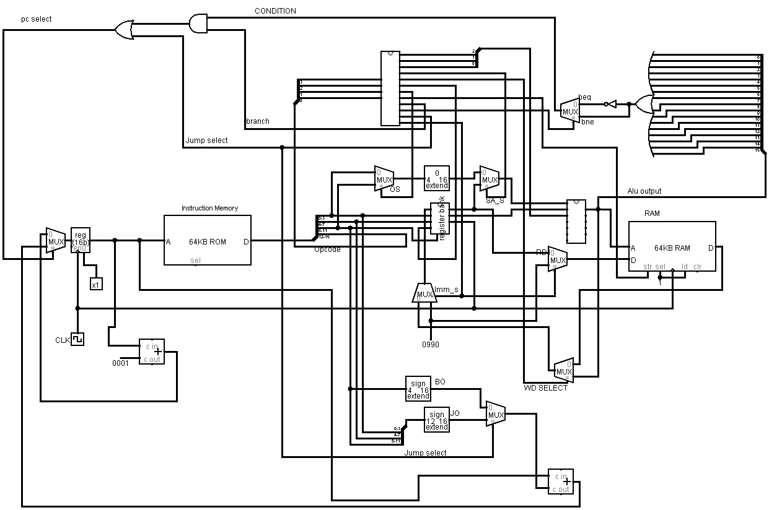
COMPLETE SCHEMATIC

